Slide 1
Cloud Computing and Big Data Cloud overview and introduction
Oxford University
Software Engineering Programme
Nov 2015

Slide 2
Contents
Definitions
Origins of Cloud Computing
Case Studies and Motivations

Slide 3

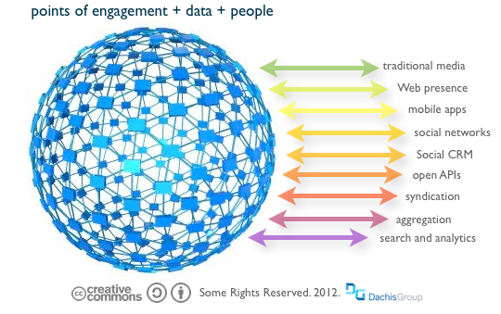
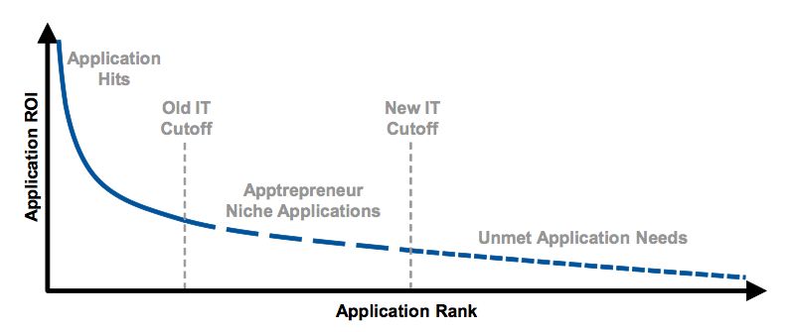
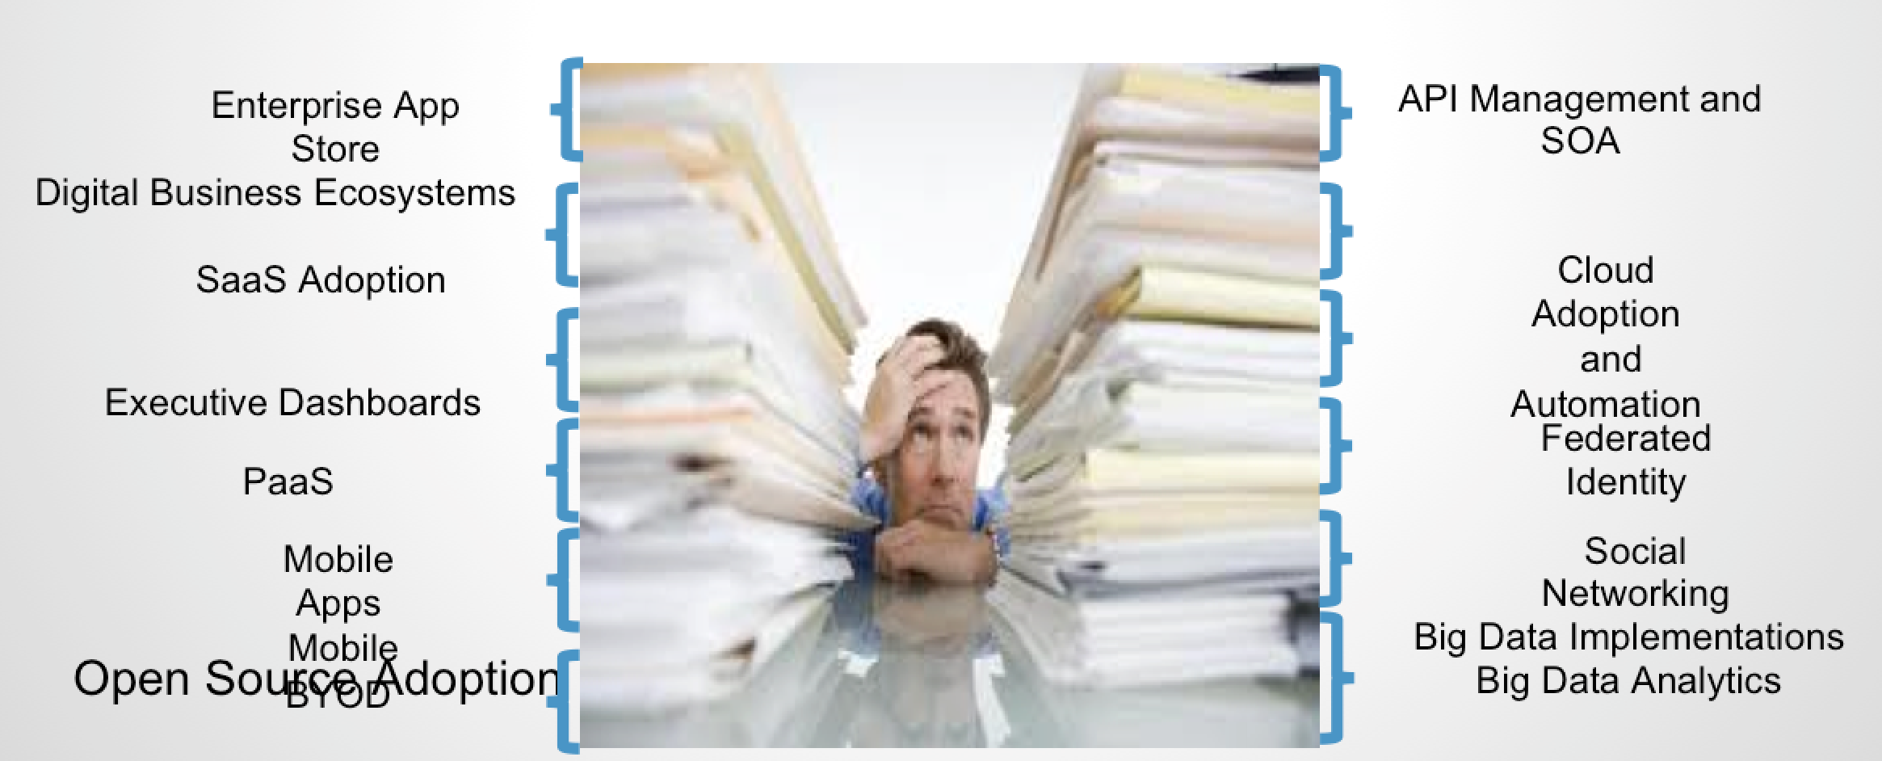
Drivers for a new IT model

Slide 4
What is Cloud?
Depends who you are
My daughter: iCloud (her music in the cloud)
My mum: gmail (her email in the cloud)
My VP sales: Salesforce (his prospects in the cloud)
Sysadmin: Amazon/Rackspace/etc (his infrastructure in the cloud)
*: what you care about, self-provisioned, managed, metered and paid per use, in the cloud

Slide 5
Cloud Computing Definition (NIST)
On-demand self-service
Users can provision resources without human intervention
Broad network access
Heterogeneous access to resources
Resource pooling
Multi-tenant shared capabilities
Rapid elasticity
Services can scale up and down automatically
Measured service
Resources can be metered and charged for based on real-world measures

Slide 6
Cloud Native http://pzf.fremantle.org/2010/05/cloud-native.html
Distributed/Dynamically Wired (works properly in the cloud)
Supports deploying in a dynamically sized cluster
Finds services across applications even when they move
Elastic (Uses the cloud efficiently)
Scales up and down as needed
Works with the underlying IaaS
Multi-tenant (Only costs when you use it)
Virtual isolated instances with near zero incremental cost
Implies you have a proper identity model
Self-service (in the hands of users)
De-centralized creation and management of tenants
Automated Governance across tenants
Granularly Billed and Metered (pay for just what you use)
Allocate costs to exactly who uses them
Incrementally Deployed and Tested (seamless live upgrades)
Supports continuous update, side-by-side operation, in-place testing and incremental production

Slide 7
Origins of Cloud Computing
Virtual Machines on Mainframes
VM/370 – 1972
Grid Computing
Grid computing is the collection of computer resources from multiple locations to reach a common goal.
Software-as-a-Service
Salesforce.com 1999
Amazon AWS
2002

Slide 8
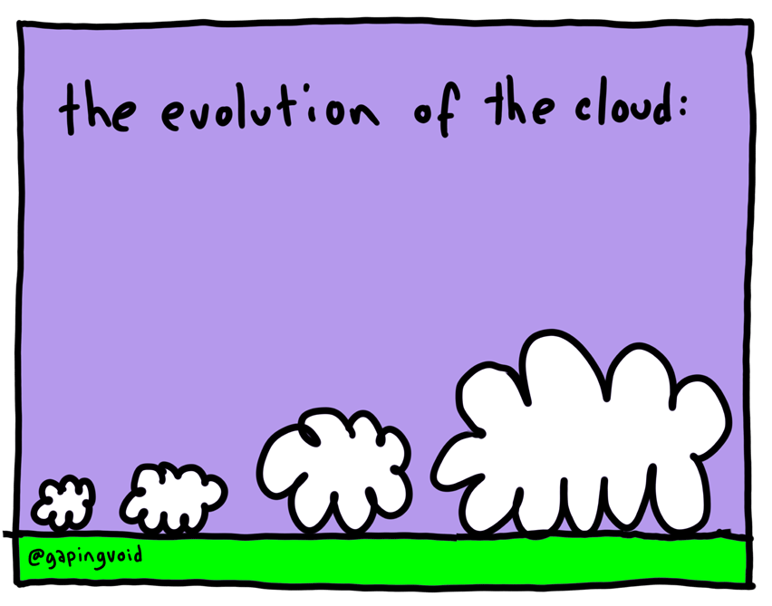

Slide 9
Evolution of Cloud
Containers / Platforms
Infrastructure as a Service
Software as a Service
Virtualization
Grid Computing
Cluster Computing

Slide 10
Case studies

Slide 11
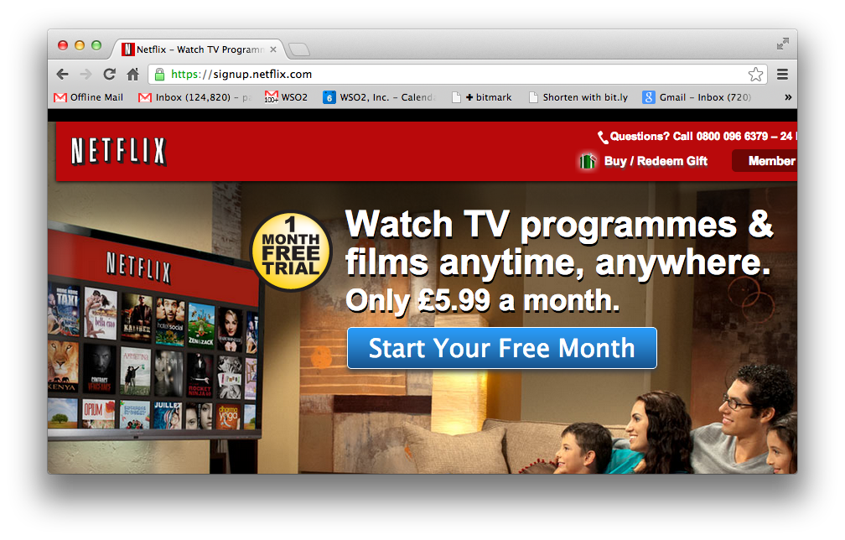

Slide 12
Netflix
A REST and Cloud based SOA approach
Continuous Delivery
100% Based in the cloud
See excellent presentations from Adrian Cockcroft
e.g. http://www.slideshare.net/adrianco/global-netflix-platform

Slide 13
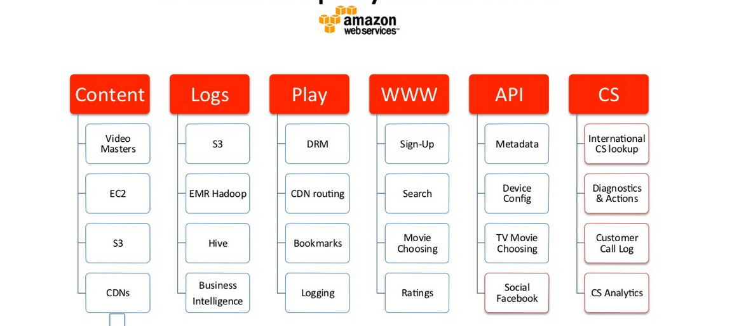
Netflix Deployed on AWS

Slide 14
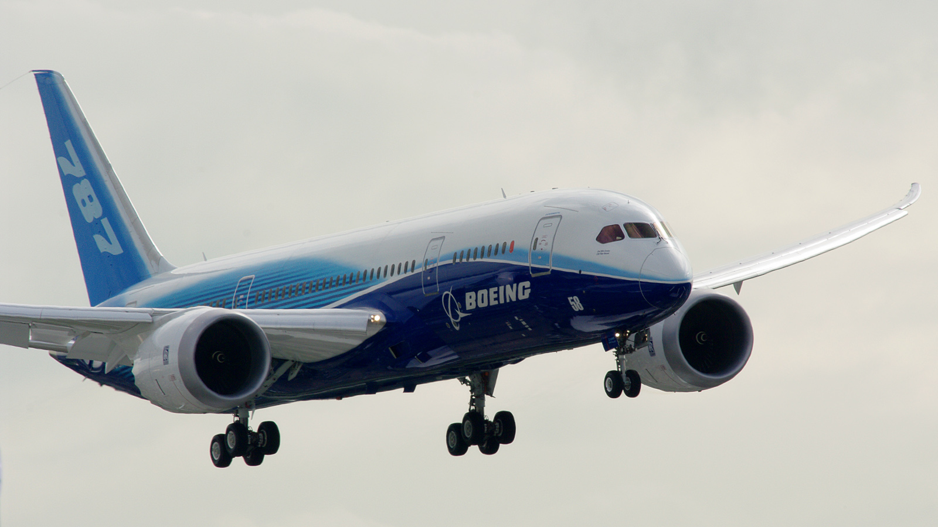
Boeing Digital Airline

Slide 15
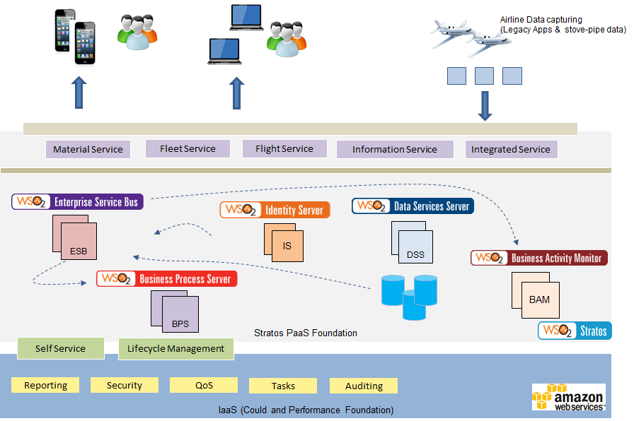
Case Study : Boeing - A PaaS based Integration and API ecosystem
Notes:
Keywords Cloud, API Integration, Billing and Monetization, Governance
Solution Targets to cater for 13,000 Boeing airplanes in Service at 900 airlines
A solution that can scale for 90 million transactions per month (as an end state)
PaaS solution to integrate airlines and OEM data
Reusable app services
Open architecture and modular design

Slide 16
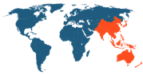
Case Study : Multi-tenanted Mobile Orchestration Gateway Platform
Customer
One of the largest global networking solutions providers required to build a mobile services orchestration gateway platform, enabling mobile providers to simplify QoS service access to their external business partners.
Challenge
- Build a mobile services orchestration gateway than can scale upto 40,000 TPS with 99.999% service availability.
Extensible architecture capable of interfacing with multiple protocols such as XMPP, Diameter whilst maintaining pre-defined SLAs and throughput.
- Integrating with ASR5000K, Third-party PCRF systems
- Multi-tenancy support for API lifecycle management.
- Multi-geographical deployment with autoscaling and failover compensation.
Solution
- Rebuilt an 18 month project in 4 weeks
- API Governance powered by multi-tenanted API Manager cluster with enforced security and lifecycle management.
- Business logic through ESB mediators exposed as REST APIs.
- Stateful caching using Cassandra
- Analytics and monetization of API usage using BAM integrated with enterprise licensing platform.
- Partner Onboarding interfaces and authorization workflows.
- Enterprise-grade cloud deployment based on Stratos PaaS foundation with native support for multi-tenancy, resource pooling and elastic scaling.
Notes:
Keywords Cloud, API Management, Statistics and Monetization, Openstack
Solution 40,000 transactions per second
Support for 99.999% service availability
Support for autoscalling based on Stratos2 implemented on top of Openstack
Tenant based access control for enterprises.
Unified enterprise onboarding
Licensing integration, statistics and monertization

Slide 17
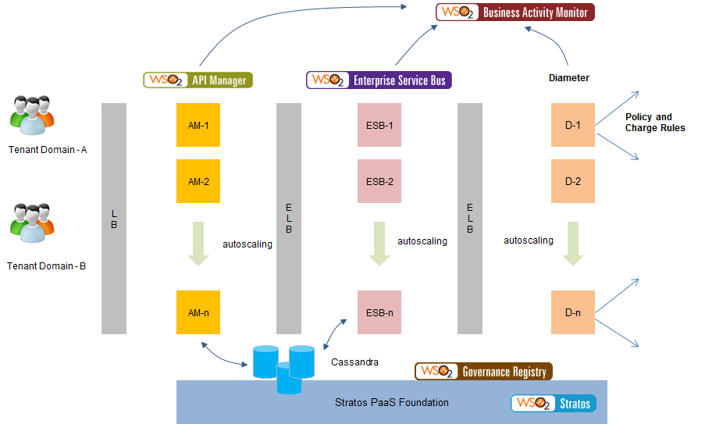
Case Study : Multi-tenanted Mobile Orchestration Gateway Platform
Notes:
Keywords Cloud, API Management, Statistics and Monetization, Openstack
Solution 40,000 transactions per second
Support for 99.999% service availability
Support for autoscalling based on Stratos2 implemented on top of Openstack
Tenant based access control for enterprises.
Unified enterprise onboarding
Licensing integration, statistics and monertization

Slide 18
Pay TV company
Needed to scale up to provide instant pay-as-you-go on mobile devices
Support Disaster Recovery (DR)
Elastic Scale e.g. during an important football match

Slide 19
Architecture
Clients
Clients
Clients
Existing architecture
(no changes)
RESTful Services
Notification
Integration Layer
Replication
Cloud/NoSQL Multi-Master Database
Cloud Platform
Cloud Datacenter

Slide 20
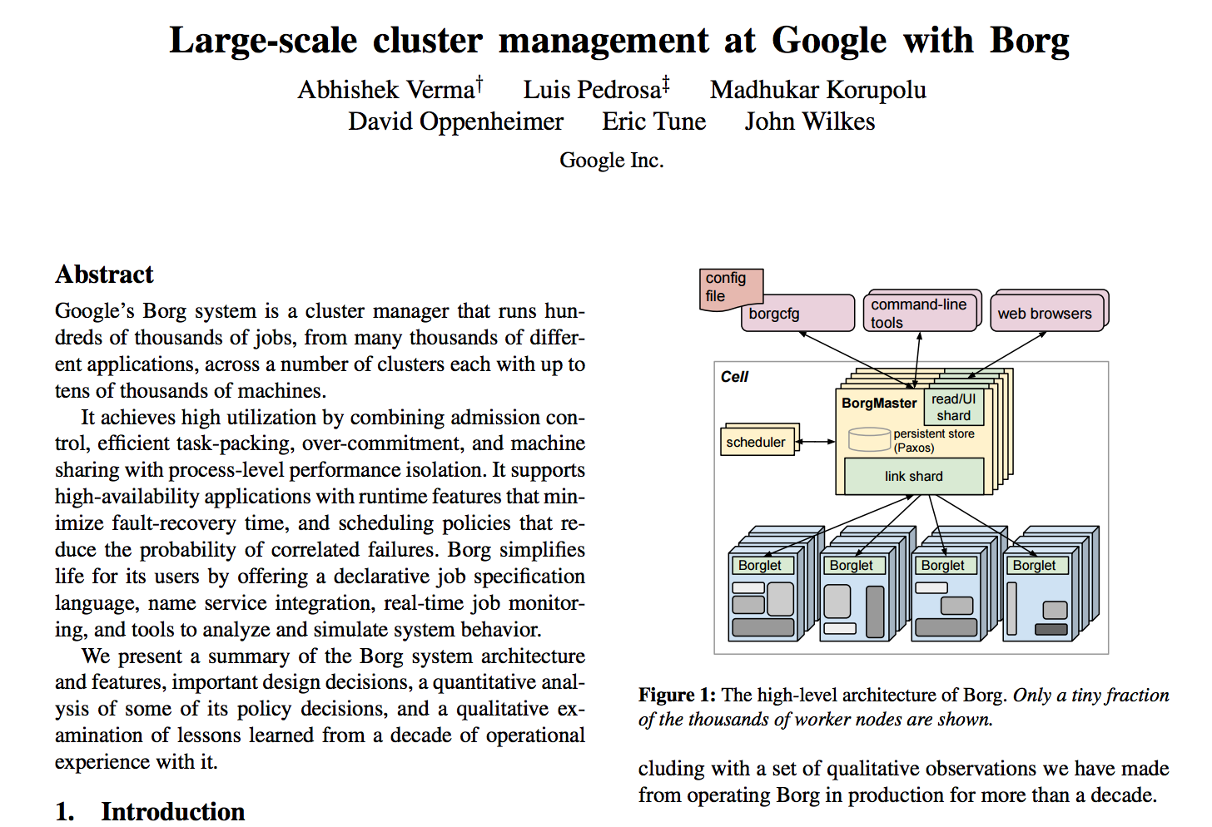

Slide 21
Questions?

